Slide 1


STUDENT PERFORMANCE
ANALYSIS PIPELINE
Building a Data-Driven System for Mastery Tracking, Difficulty Analysis & Personalized Recommendations
By Khoa Hoang, Mujeeb Ali

Slide 2


Pipeline Overview
data_loader.py – Data ingestion & cleaning
progress.py – Student progress computation
difficulty.py – Topic difficulty scoring
clustering.py – Student grouping
prediction.py – Mastery prediction
recommendations.py – Tutor recommendations
dashboard.py – Visual reports
reports.py – CSV & PDF output
logger.py – Logging
main.py – Pipeline orchestration

Slide 3











Data Input (CSV)
Data Loader
Progress Analyzer
Difficulty Scoring
PIPELINE DIAGRAM (PROFESSIONAL)
Student Clusters
Mastery Prediction
Flow of the Entire System
Recommendations
Dashboards (Visualization)
PDF / CSV Reports

Slide 4

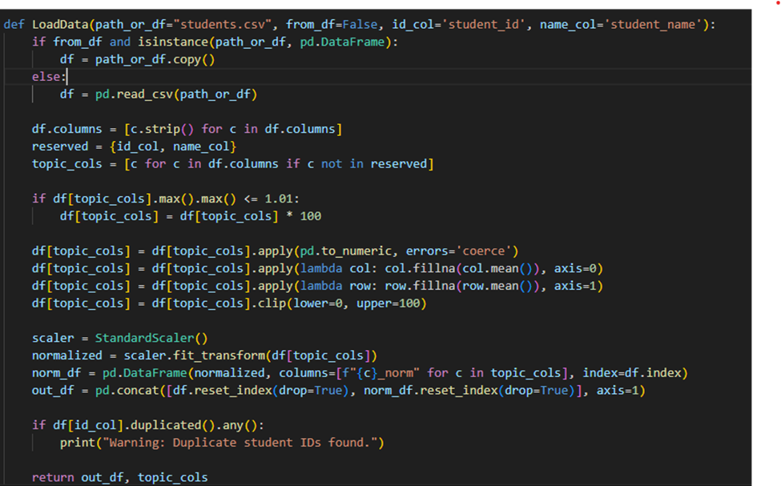
Data Loader
(data_loader.py)
Functions
Load CSV / DataFrame input
Extract topic score columns
Clean missing values
Normalize topic scores
Output
Clean DataFrame
List of topic names

Slide 5
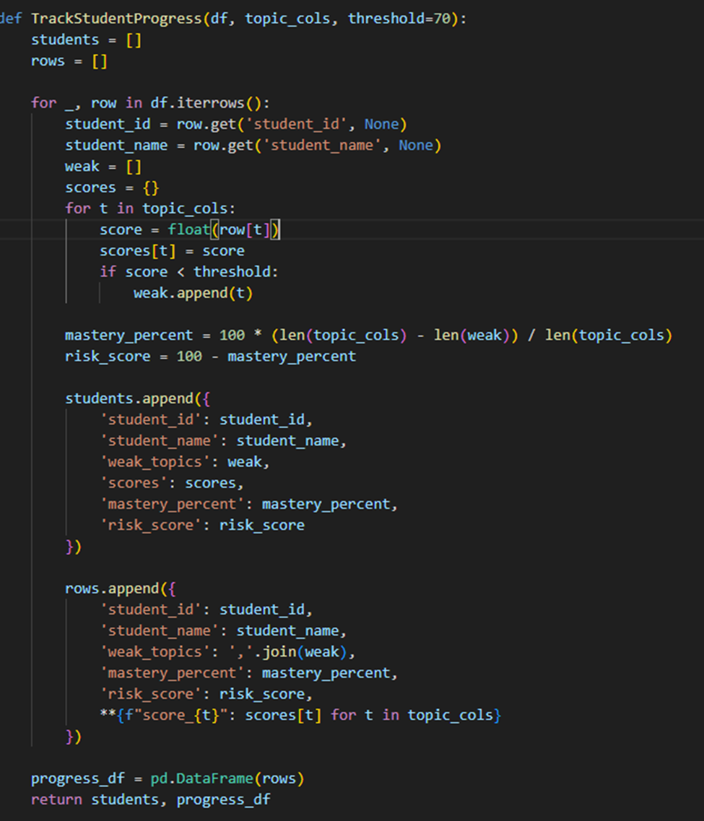

Student Progress (progress.py)
What it Computes
Student performance across topics
Weak topics for each student
Mastery percentages
Student–Topic Score Matrix
Uses
Forms the backbone for recommendations & prediction

Slide 6

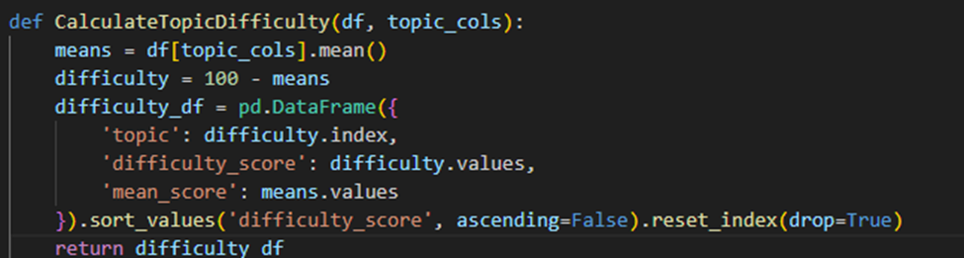
Topic Difficulty (difficulty.py)
Formula
Difficulty Score = 100 – mean (topic_score)
Purpose
Rank topics by difficulty
Identify topics needing curriculum attention

Slide 7

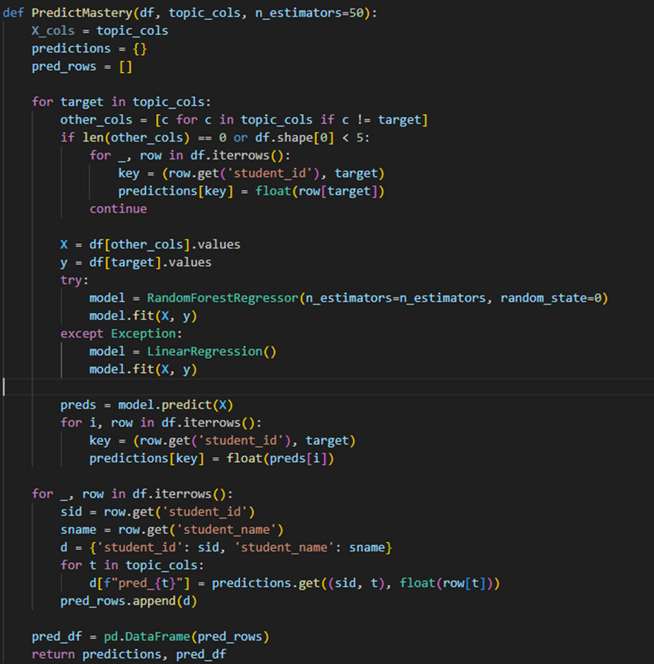
Mastery Prediction (prediction.py)
Models Used
RandomForestRegressor (primary)
LinearRegression (fallback)
Predicts
Student–Topic mastery scores
Outputs
Dictionary: (student, topic) → predicted mastery
Predicted mastery DataFrame

Slide 8

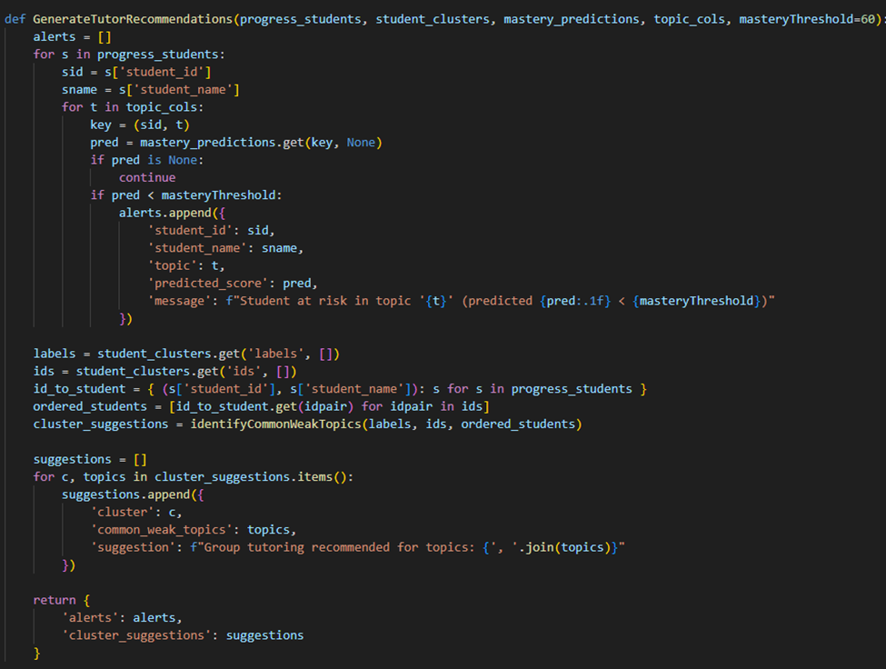
Recommendation Engine
(recommendations.py)py)
Logic
Combine predicted mastery + clusters
Detect at-risk learners
Suggest targeted tutoring sessions
Outputs
Individual student alerts
Cluster-based recommendations

Slide 9
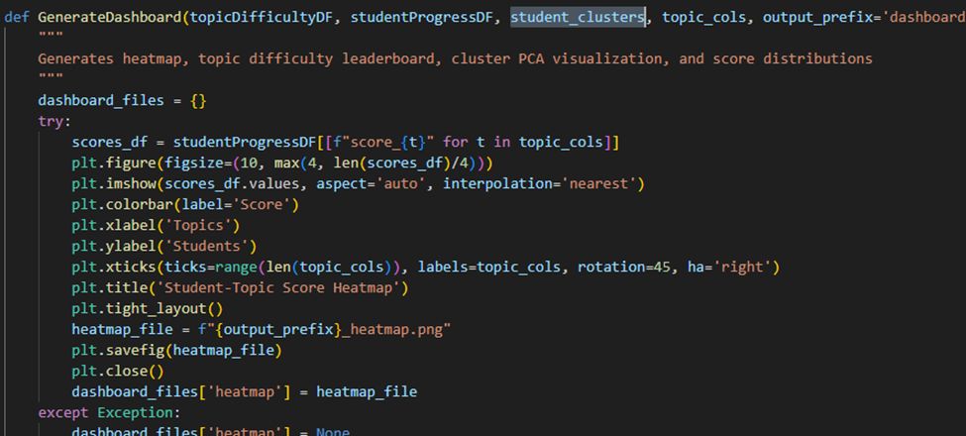


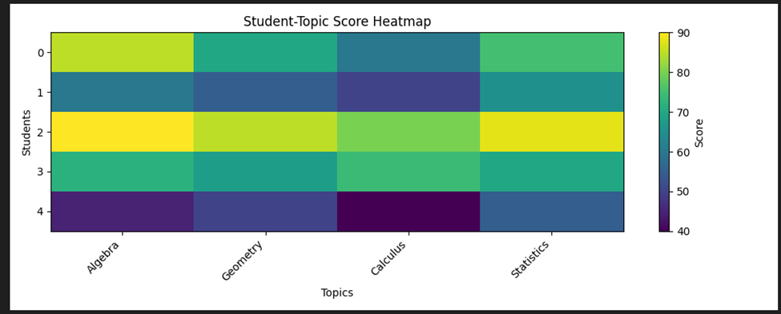
Dashboard Generator (dashboard.py)
Visualizations Produced
Heatmap: student × topic mastery
Topic difficulty ranking chart
PCA scatterplot for clusters
Export Format
PNG image files for embedding in reports

Slide 10
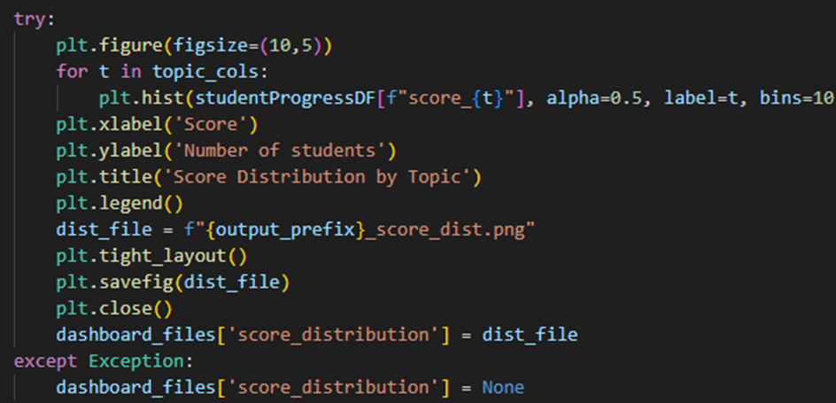
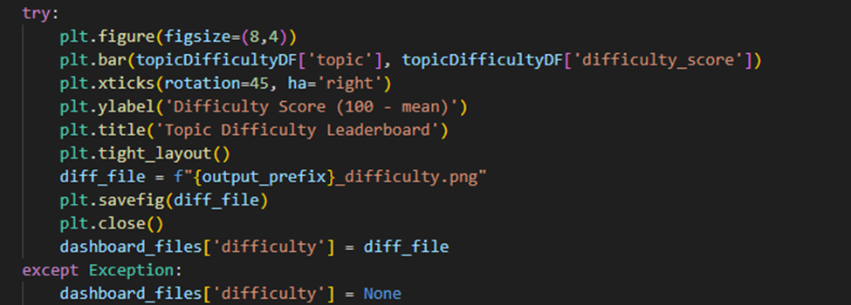
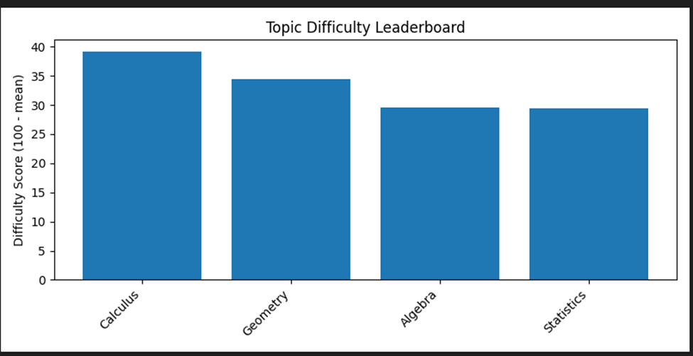
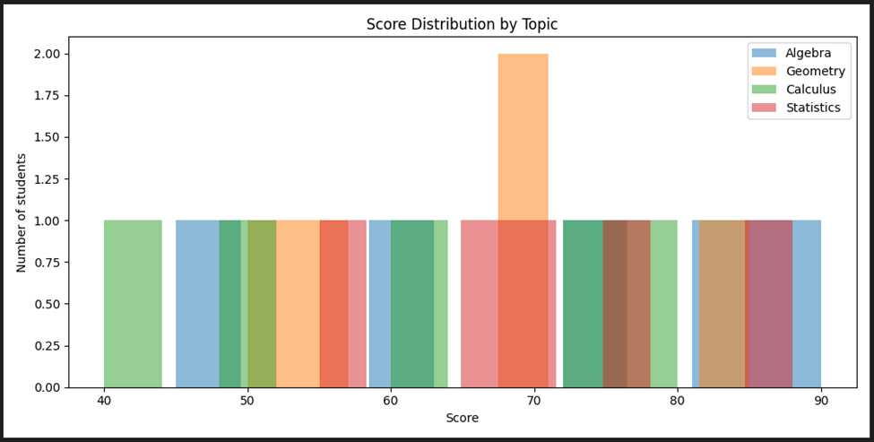

Slide 11

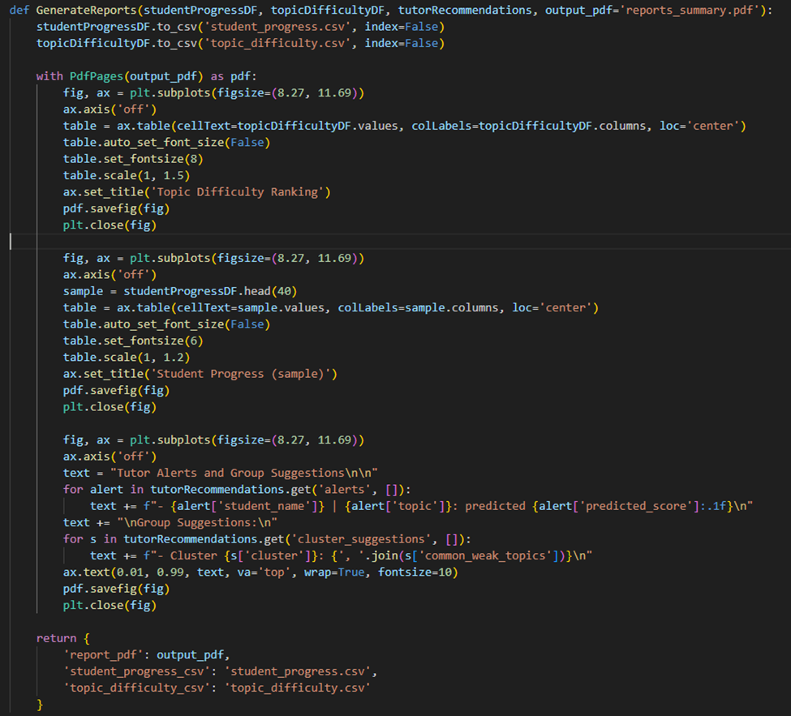
Report Generator (reports.py)
Exports
CSV: progress results
CSV: difficulty scores
PDF combining:
Tables
Insights
Alerts
Recommendations

Slide 12
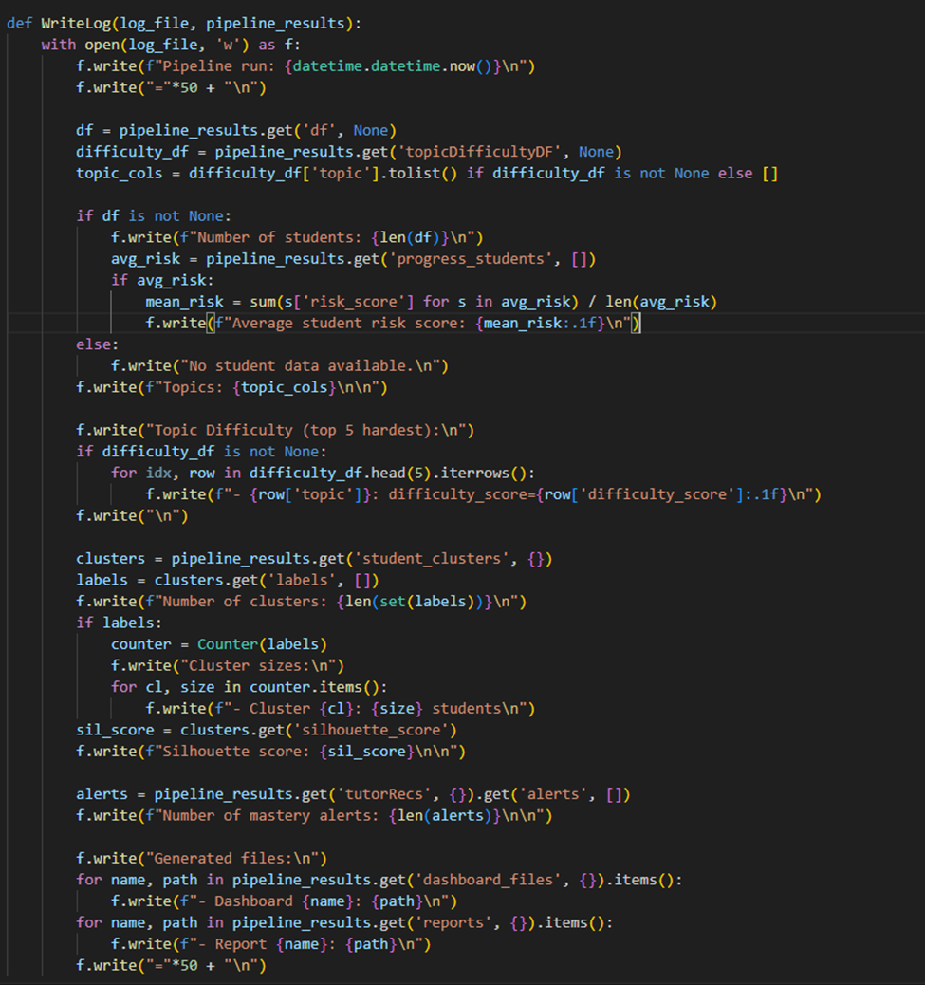


Logging (logger.py)
Logs Include
Dataset stats
Difficulty report
Clustering summary
Alerts generated
Output files created

Slide 13

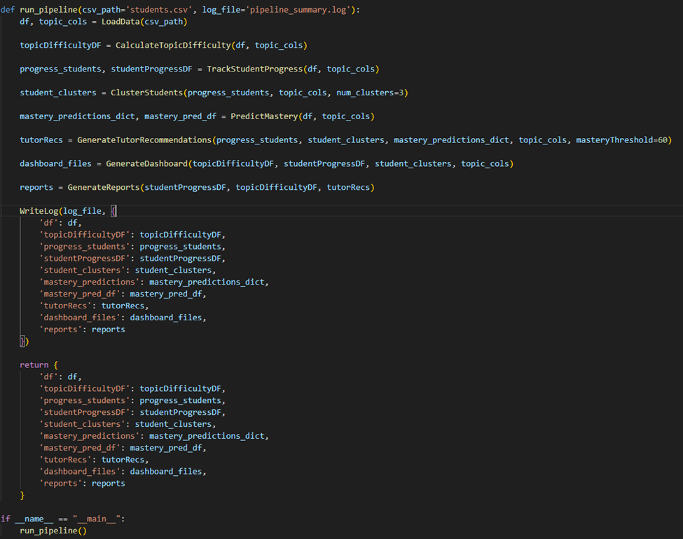
Main Runner (main.py)
run_pipeline() executes full workflow:
Load & clean data
Compute topic difficulty
Calculate student progress
Cluster students
Predict mastery
Generate recommendations
Produce dashboards
Export reports
Log summary
Final Output
A dictionary containing all intermediate & final results

Slide 14




System Architecture (Summary)
Input → Processing → Output
Input
Processing
Output
CSV student scores
difficulty, progress, clusters, prediction
PDFs, PNGs, CSVs, Alerts

Slide 15


THANK YOU!
Questions?
Let’s improve learning outcomes with Data Science!

